Slide 1
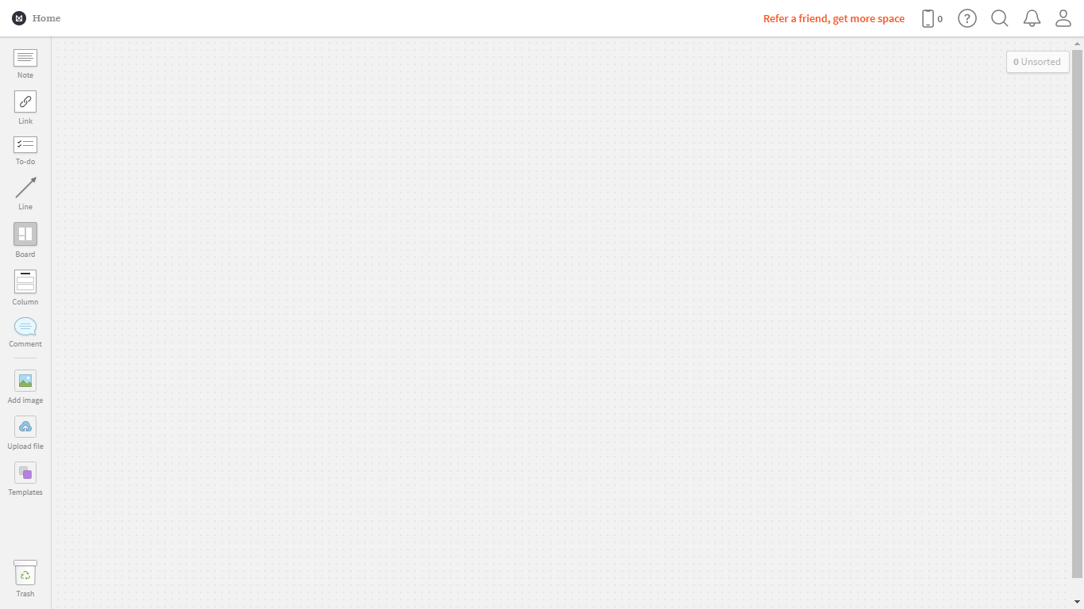

Slide 2
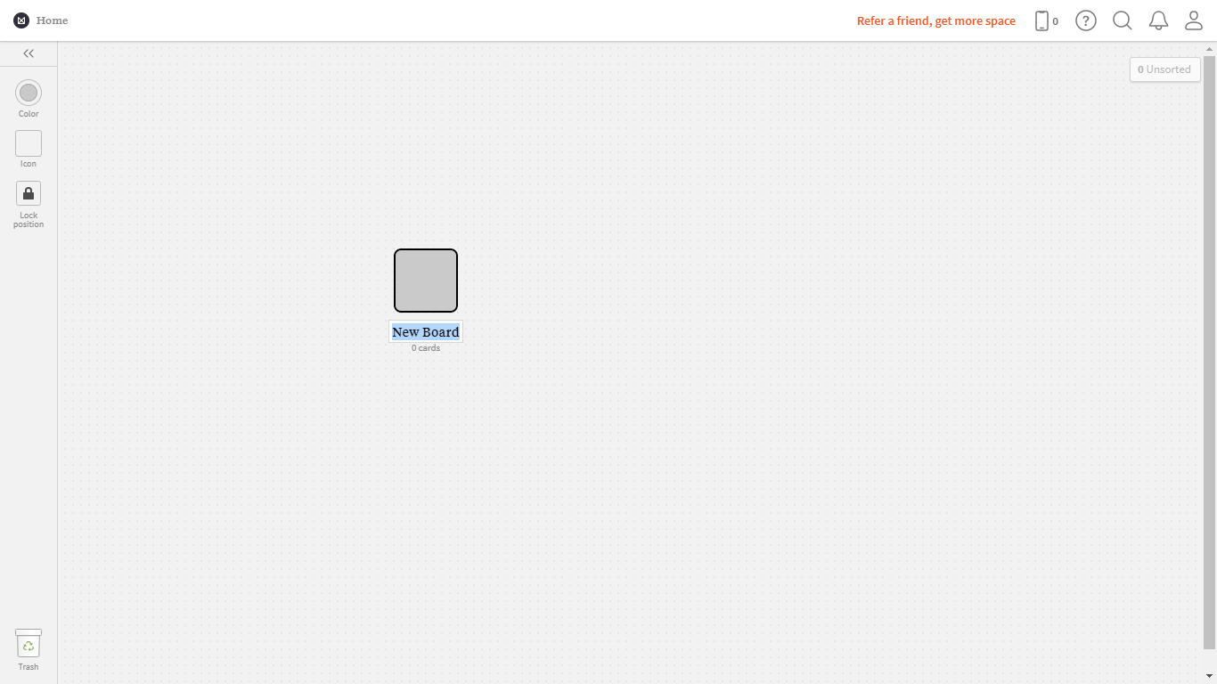

Slide 3
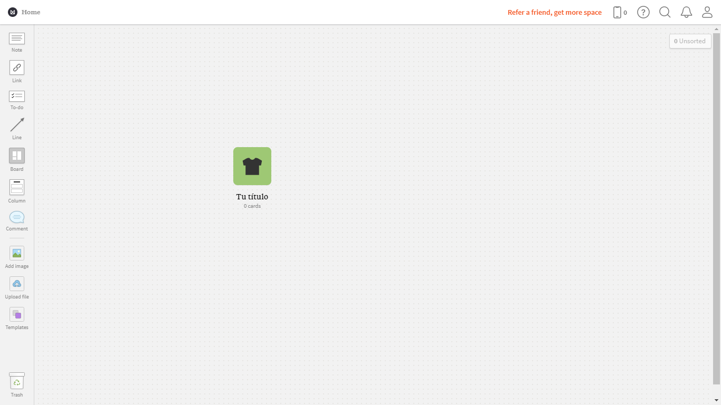

Slide 4
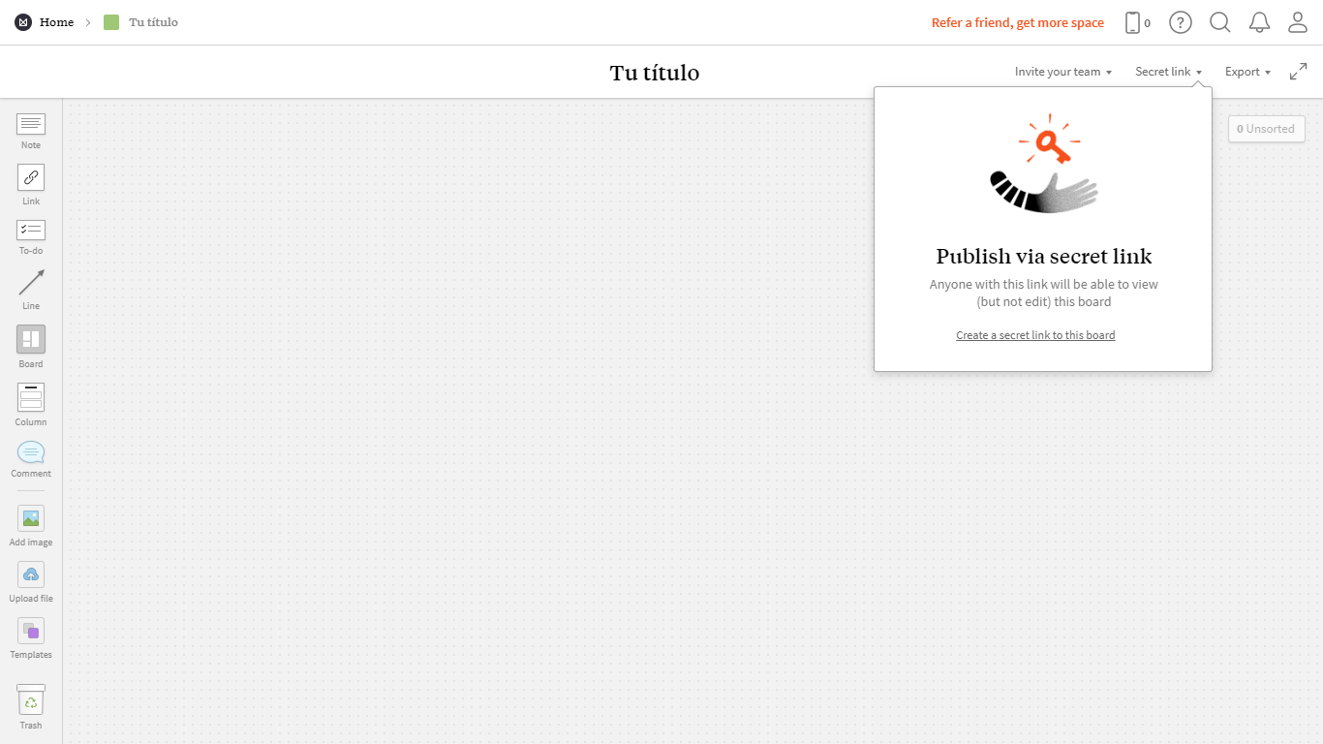

Slide 5
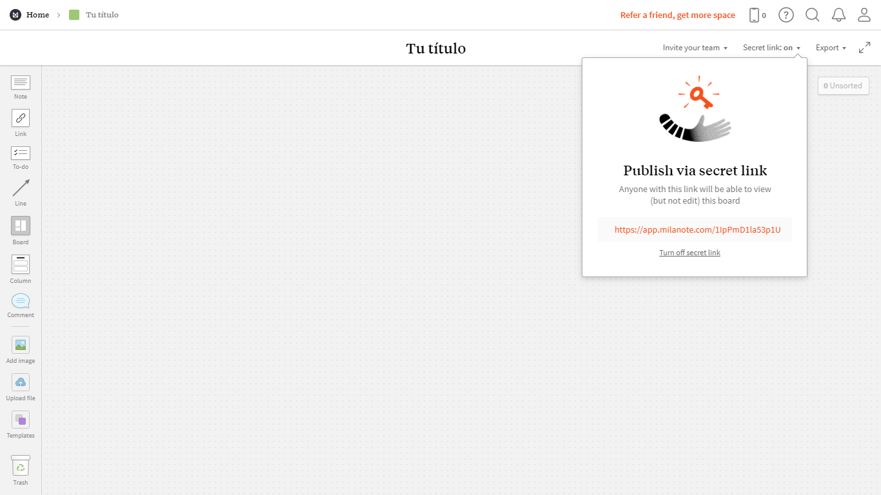

Slide 6
https://app.milanote.com/1JGuAm1wwOXb6e?p=CKkb3hZhxyL
https://app.milanote.com/1JoBGL1ZH8qE2Z

